Slide 1









Airline Company Stats
PRESENTATION 2026
Student Name
Student Email
Guide
Bhumi Sakariya
Bhathiwala Heer
bhumisakariya2112@gmail.com
heer.bhathiwala1174@gmail.com
Jyoti prajapati

Slide 2

OUTLINE
Abstract of the Project
Problem Statement
Proposed Solution
System Architecture
Live Demo of the Project
Embedded Video of Project
Conclusion
Future Scope

Slide 3
Abstract
Introduction
Overview
Objectives
Methodology
Key Findings
Embedded Video of Project
Conclusion
Future Scope

Slide 4
Introduction:
This Airline Performance Dashboard provides a concise analysis of the Indian aviation market, tracking $2M in total revenue and an average customer rating of 3.28. By visualizing key metrics across major carriers like Air India and Vistara, the report highlights the relationship between ticket pricing, flight timing, and service class. It offers a clear geographic and financial breakdown, helping stakeholders identify high-value routes and compare the market share of premium versus budget airlines.

Slide 5
Overview :
This project presents an interactive business intelligence dashboard developed in Power BI to analyze airline industry metrics , specifically focus on pricing strategies, customers rating and flight duration across major Indian cities . By synthesizing complex datasets into visual insights , the project aims to identify the relationship between flight class, carrier reputation , and cost efficiency.

Slide 6
Objectives :
The primary goal was to explore how airline pricing fluctuates based on service class , destination , and departure timing . Specifically, the analysis sought to determine:
The impact of Flight Class (Business VS Economy) on the total revenue share.
The correlation between Customer Ratings and airline performance.
Price variation across key metropolitan hubs including Bangalore , Delhi , Hyderabad , Kolkata , and Mumbai.

Slide 7
Methodology:
The data was processed and visualized using a variety of analytical charts . Key performance indicators like Average Rating (3.28), Total Revenue (RS.2M),and Price Ranges (RS.5000 to 18000) were established as baseline metrics. The dashboard utilize:
Donut & Pie Charts for market share of classes and airline ratings.
Bar & Column Charts for price distribution by airline and city.
Geospatial Mapping to visualize flight route and destination density.
Slicers for real-time filtering by departure time, source city, and destination.

Slide 8
Key Findings:
The analysis reveals that while Business Class accounts for a significant portion of pricing (approx. 32%), Economy Class remains the volume driver at 67%. Air India and Vistara emerge as dominant players in terms of rating distribution. Furthermore, pricing data indicates that destination cities like Mumbai and Bangalore command the highest a average ticket prices, reflecting high-demand corridors.

Slide 9

Problem Statement
Price Transparency: Simplifies the massive gap between the minimum ($5,000) and maximum ($18,000) ticket costs.
Value Assessment: Checks if expensive airlines actually earn the best customer ratings.
Revenue Mix: Identifies how much profit comes from Business vs. Economy class.
Route Hotspots: Pinpoints which cities (like Mumbai) are the most expensive to fly into.
Schedule Impact: Shows how departure times (Morning vs. Night) affect the average ticket price.

Slide 10

Proposed Solution
This project provides a Data-Driven Decision Hub for the Indian aviation market. It solves the problem of high price volatility (₹5k–₹18k) by mapping exactly how class, timing, and carrier choice impact costs. By identifying Vistara and Air India as premium value leaders and Mumbai/Bangalore as high-cost zones, the dashboard allows travelers to optimize their spend. The ultimate solution moves from static analysis to AI-powered forecasting, using machine learning to predict price drops and automate booking for maximum savings.

Slide 11
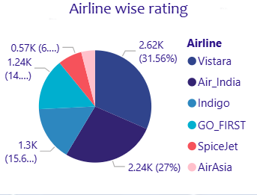
Live Demo of Project
Here’s the list of some demo of the projects -
Market Leaders: Vistara holds the largest share at 31.56% (2.62K), closely followed by Air India at 27% (2.24K).
Budget Carriers: Indigo and GO_FIRST make up the middle segment, while SpiceJet and AirAsia represent the smallest slices of the data.
Purpose: The visual quickly identifies which airlines are most prominent in your dataset based on their ratings or frequency.

Slide 12
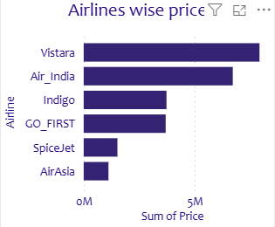
Vistara and Air India lead by a wide margin, showing they generate the most revenue in your Indian aviation data .
Indigo and GO_FIRST show moderate revenue levels .
SpiceJet and AirAsia are at the bottom, indicating they are lower-cost or lower-volume options in this study.

Slide 13
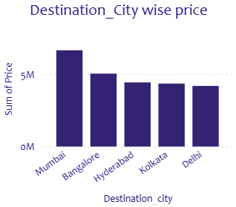
​Mumbai is the most expensive destination, with the highest "Sum of Price" exceeding 5M.
​Bangalore is the second most costly hub, followed by Hyderabad, Kolkata, and Delhi.
​The chart clearly shows that travel to Mumbai and Bangalore requires a higher budget compared to other major Indian cities.

Slide 14
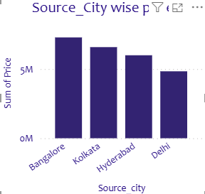
Bangalore is the clear leader: It is the only city significantly outperforming the 5M threshold.
Delhi is the outlier: It’s the only city in this set falling below the 5M mark.
The Trend: There is a steady downward gradient in total price as you move from South (Bangalore) to North (Delhi) based on these specific four cities.

Slide 15
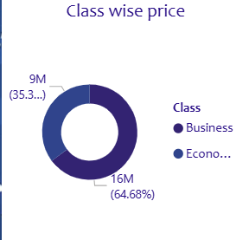
Bangalore is the clear leader: It is the only city significantly outperforming the 5M threshold .
Delhi is the outlier: It’s the only city in this set falling below the 5M mark .
The Trend: There is a steady downward gradient in total price as you move from South (Bangalore) to North (Delhi) based on these specific four cities.

Slide 16

Future Scope
Price Prediction:
Adding a feature that tells users whether to “Buy now” or “Wait” by predicting if prices will go up or down in the future.
Live Updates:
Connecting the dashboard to live websites so it shows today’s actual ticket prices instead of old data.
Holiday & Festival Analysis:
Tracking how prices spike during major events like Diwali or New Year to help travelers plan better.

Slide 17
Customer Review Analysis:
Looking at actual written comments (not just star rating ) to
Find specific problems like “bad food” or “fight delays.”
Mobile App Version:
Turning this dashboard into a user-friendly mobile app so travelers can check these stats on the go.

Slide 18

Conclusion
This project solves the problem of high price volatility and service uncertainty in the airline market . By analyzing 2M (Rs) in revenue, the dashboard concludes that while Economy class dominates in volume, Business Class and top-rated carriers like Vistara are the main value drivers. With hub like Mumbai and Bangalore identified as high-cost zones, the data proves that strategic timing is essential for cost control . The future scope is to move from analysis to prediction using Machine Learning , turning these insights into a real-time tool for smarter , cheaper travel.

Slide 19
Thank You
Notes:
thank you very much for joining this PPT, keep learning.
19

